Slide 1
Managing Linux Processes & Services

Slide 2
What Exactly Is a Process?
a process is a program that has been loaded from a long-term storage device, usually a hard disk drive, into system RAM and is currently being processed by the CPU on the motherboard.

Slide 3
What Exactly Is a Process?
Binary executables : created as a text file using a programming language, such as C or C++. The text file was then run through a compiler to create a binary file that can be processed by the CPU.
Internal shell command : rpm, cd, mkdir,..
Shell scripts :

Slide 4
Types of Processes
User Processes: Some processes are created by the end user when he or she executes a command from the shell prompt or though the X Windows graphical interface.
System processes or daemons: Web server, an FTP server, a file service such as Samba, a print service such as CUPS, a logging service, and so on.
Ex: cupsd, hald, sshd,...

Slide 5
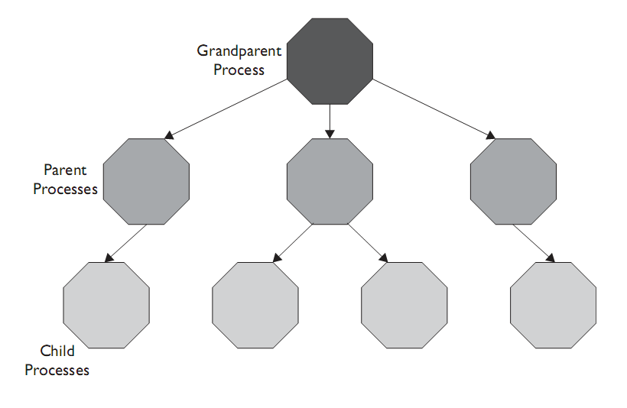
The Heredity of Linux Processes

Slide 6
The Heredity of Linux Processes
■ Process ID (PID) Number This is a number assigned to each process that uniquely identifies it on the system.
■ Parent Process ID (PPID) Number This is the PID of the process’ parent process.

Slide 7
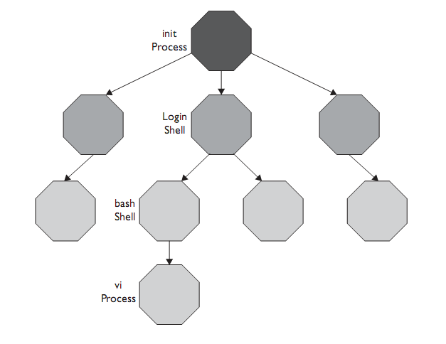
The Heredity of Linux Processes

Slide 8
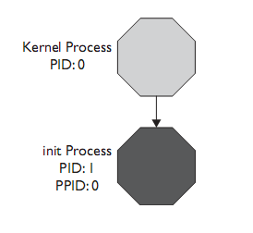
Parent Process ID

Slide 9
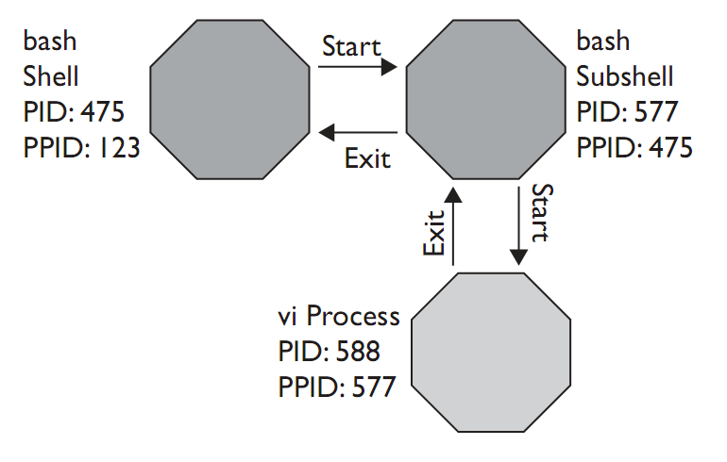
Running a process from the shell prompt

Slide 10
Manage Running Processes

Slide 11
Viewing Running Processes
Using top
Using ps

Slide 12
Using top
■ PID The process ID of the process.
■ USER The name of the user that owns the process.
■ PR The priority assigned to the process. (We’ll discuss process priorities later in this chapter.)
■ NI This is the nice value of the process. (We’ll talk about what this means later in this chapter.)
■ VIRT The amount of virtual memory used by the process.
■ RES The amount of physical RAM the process is using (its resident size) in kilobytes.

Slide 13
Using top..
■ SHR The amount of shared memory used by the process.
■ S The status of the process. Possible values include:
■ D Uninterruptibly sleeping.
■ R Running.
■ S Sleeping.
■ T Traced or stopped.
■ Z Zombied.

Slide 14
Using top...
■ %CPU The percentage of CPU time used by the process.
■ %MEM The percentage of available physical RAM used by the process.
■ TIME+ The total amount of CPU time the process has consumed since being started.
■ COMMAND The name of the command that was entered to start the process.

Slide 15
Using ps
■ PID The process ID of the process.
■ TTY The name of the terminal session (shell) that the process is running within.
■ TIME The amount of CPU time used by the process.
■ CMD The name of the command that was entered to create the process.

Slide 16
Using ps..
ps –e : viewing all processes
ps –f :
UID The user ID of the process’ owner.
PPID The PID of the process’ parent process.
C The amount of processor time utilized by the process.
STIME The time that the process started
ps -l

Slide 17
ps -l
■ S The state of the process. This column uses the following codes:
■ D Uninterruptible sleep.
■ R Running.
■ S Interruptible sleep.
■ T Stopped or traced.
■ Z Zombied.
■ PRI The priority of the process.
■ NI The nice value of the process. We’ll talk about what this means in the
next section.
■ SZ The size of the process.
■ WCHAN The name of the kernel function in which the process is sleeping.
You will see a dash (–) in this column if the process is currently running.

Slide 18
Prioritizing Processes
nice –n nice_levelcommand.
Renice n pid

Slide 19
Managing Foreground and Background Processes
fg job_ID: change job_id to foreground
bg job_ID: change job_id to background

Slide 20
Ending a Running Process
Kill
■ SIGHUP This is kill signal 1. This signal restarts the process. After
a restart, the process will have exactly the same PID that it had before.
This is a very useful option for restarting a service for which you’ve made
changes in a configuration file.
■ SIGINT This is kill signal 2. This signal sends a key sequence to
the process.
■ SIGKILL This is kill signal 9. This is a brute-force signal that kills the
process. If the process was hung badly, this option will force it to stop. However,
the process may not clean up after itself if this signal is used. The resources
allocated to the process may remain allocated until the system is restarted.
■ SIGTERM This is kill signal 15. This signal tells the process to terminate
immediately. This is the default signal sent by kill if you omit a signal in the
command line. This signal allows the process to clean up after itself before exiting.
Killall

